Slide 1
3 Remote Procedure Calls
Reference: Chapter 4
Distributed Operating Systems –
Concepts and Design
by Pradeep K. Sinha

Slide 2
Introduction
Independently developed IPC protocol is tailored specifically to one application and does not provide a foundation on which to build a variety of distributed applications
RPC emerged out of the need to for general IPC protocol that can be used for designing several distributed applications.
RPC is not universal but it provides a communication machine that is suitable for building fairly large number of distributed applications

Slide 3
Introduction
Reasons for RPC popularity:
  Simple call syntax
  Familiar semantics
  Its specification of a well-defined interface - supports compile time type checking among others.
  Ease of use
  Generality
  Efficiency due to rapid communication
  Can be used as an IPC mechanism for both across machines and within a give machine

Slide 4
The RPC Model
Similar to ordinary procedure call model in the following ways:
  Caller places arguments to the procedure
  Control transferred to sequence of instructions
  Procedure executed in a new execution environment
  Control returns to the caller.
In RPC however, the procedure may be local or remote
RPC uses message passing scheme for information exchange

Slide 5
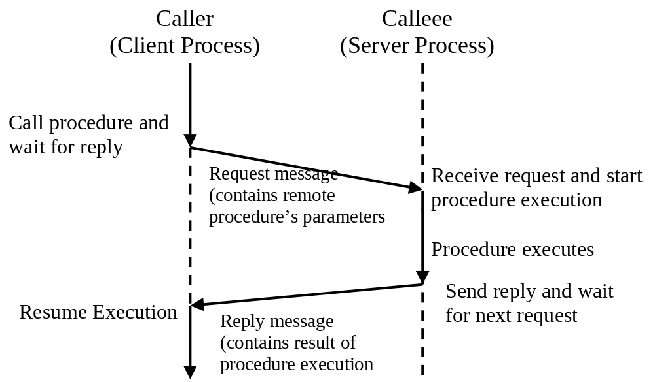
The RPC Model

Slide 6
Transparency of RPC
Both local and remote procedure calls should be (effectively) indistinguishable to programmers
This requires:
  Semantic transparency
  Syntactic transparency
What differentiates remote from local PC?
  Procedure executed in a different environment
  More prone to failures
  Consumes more time
These makes semantic transparency more difficult to implement

Slide 7
Implementing RPC Mechanisms
Based on stubs concepts that provides a normal procedure call abstraction by concealing from the programs interface underlying RPC system.
Has 5 elements
  The client
  The client stub
  The RPCRuntime – communication package
  The server stub
  The server

Slide 8
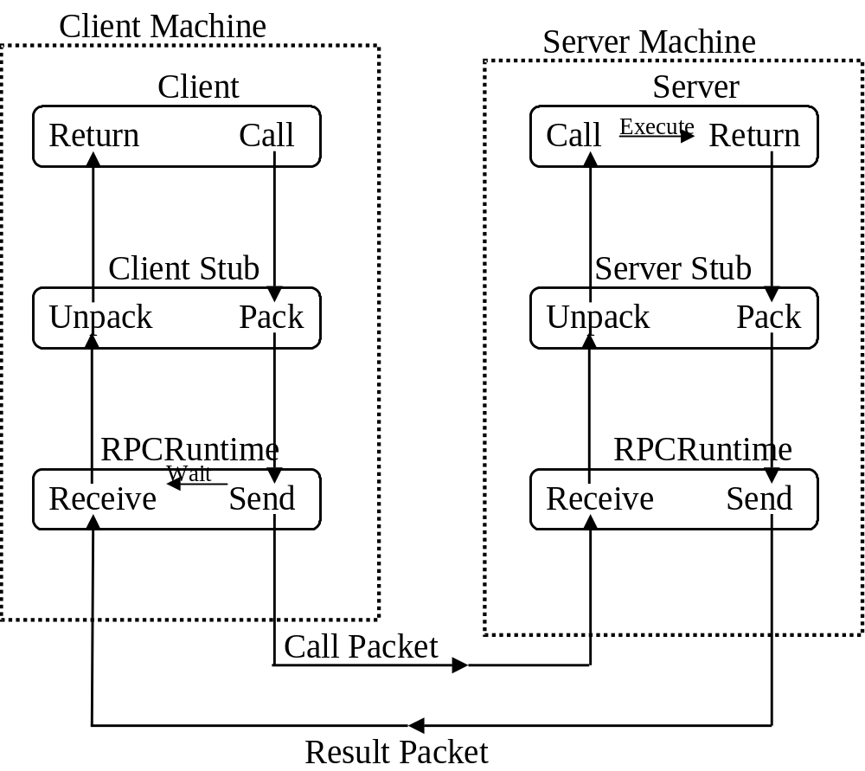
Implementing RPC Mechanisms

Slide 9
Marshalling Arguments and Results
Marshalling – encoding and decoding into/from stream form
Must reflect the structures of all types of program objects used in the concerned language
Are of two types:
  Those provided by RPC software – supports pre-defined data types
  User-defined –for supporting user-defined data types

Slide 10
Server Management
Server implementation
  Stateful servers – stores clients information from one RPC to the next
  Stateless servers- does not maintain any client state information
Server Creation
  Instance-per-call server – call duration
  Instance-per-session servers
  Persistent servers

Slide 11
Server Management - Examples
Steteful Servers
  Read(fid, n, buffer) – get n bytes of data from file whose Id is fid into the buffer named buffer.
  Write(fid, n buffer) - the server takes n bytes of data from the specified buffer, writes into fid at the byte position currently addressed by read-write pointer.
Stateless Servers
  Read(filename, ,position,n, buffer) – get n bytes of data from file whose Id is filename into the buffer named buffer.
  Write(filename,position, n buffer) - the server takes n bytes of data from the specified buffer, writes into fid at the byte position position.

Slide 12
Parameter-Passing-Semantics
Call-by-value – parameters copied onto a message
Call-by-reference – passing pointers is meaningless because of the differences in address spaces. Only possible incase of shared memory

Slide 13
Call Semantics
Failures during message passing may affect the RPC, hence the need for call semantics:
  Possibly Or May-Be Call Semantics – caller continues after a time-out
  At-Least-Once Call Semantics
  Exactly-Once Call Semantics

Slide 14
Communication Protocols for RPCs
The Request Protocol – (the R Protocol)
  Nothing to return
  Acknowledgement not required
  Caller continues with execution after the call
  Provides May-Be-Call Semantics
  This RPC is asynchronous
  E.g. A time server node in a DS may send synchronization messages every T seconds so losing a message or two is acceptable

Slide 15
Communication Protocols for RPCs
The Request/Reply Protocol – (the RR Protocol)
  Suitable for simple RPCs – all arguments/results fit in a single packet buffer and has less transmission time
  Based on implicit acknowledgement
  Has no failure-handling capabilities
  Uses timeouts-retries technique to handle failures, hence provides at-least-once call semantics
  Can support exactly-once semantics if the server keeps records of replies.

Slide 16
Communication Protocols for RPCs
The Request/Reply/Acknowledgement-Reply Protocol – (the RRA Protocol)
  Client acknowledge the receipt of reply messages and the server uses this to delete reply information from its cache
  Since acknowledgement messages may get lost, both messages (the reply and the acknowledgement) have identifiers for matching purposes
  Exercise:
    Is there RARA Protocol?

Slide 17
Complicated RPCs
Involving long duration
  Periodic probing of the server by the client
  Periodic generation of acknowledgement by the server
Involving arguments/results that are too large
  Use several physical RPCs to handle one large logical RPC
  Use multidatagram messages

Slide 18
Server Binding
  Client stub needs to know the location of the server through binding
  Servers ‘export’ their operations and clients ‘import’ via the RPCRuntime.
  Interface names (type and instance) are used for servers
  Servers can be located by use of ‘broadcasting’ or ‘Binding Agent’.

Slide 19
RPC in Heterogeneous Environments
  Three types of heterogeneity to be addressed:
    Data representation – how the particular machine represents data. E.g. 1’s or 2’s compliments (research!)
    Transport protocol – making the RPC system independent of the protocol
    Control protocol – must be independent of the control information in each transport packet
  Delay decisions until bind time

Slide 20
Light Weight RPC
  Recall the differences between Monolithic-kernel operating systems and microkernel operating systems. The two types of communication traffic (cross-domain and cross-machine)
  The LRPC is a communication facility designed and optimized for cross-domain communications
  Uses simple control/data transfer and simple stubs.
  Designed for concurrency

Slide 21
Optimizations for Better Performance
  Concurrent access to multiple servers – using threads, early reply approach or call buffering approach
  Serving multiple request simultaneously
  Reducing per call workload of servers
  Reply caching of Idempotent remote procedures
  Proper selection of timeout values
  Proper design of RPC protocol specification

